Slide 1
CS 4032 – Web Programming
Dr. Hassan Sartaj

Slide 2
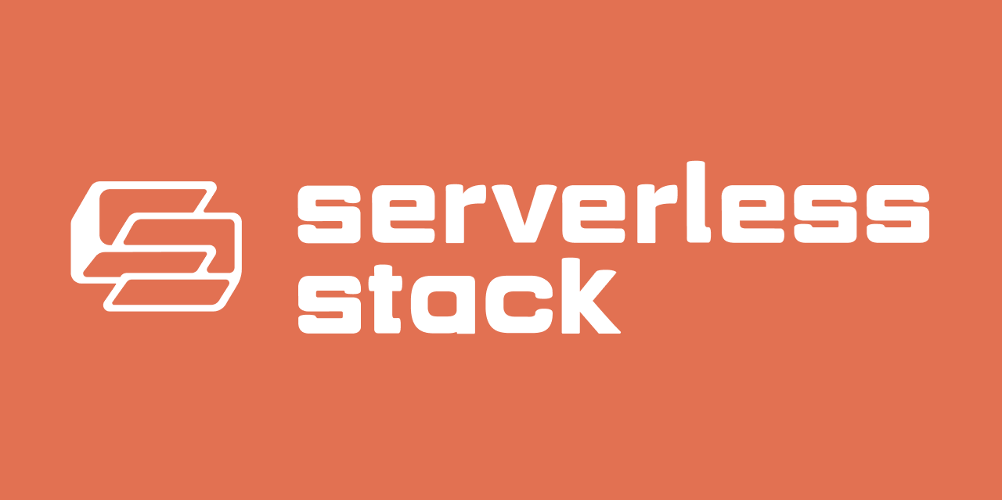

Slide 3
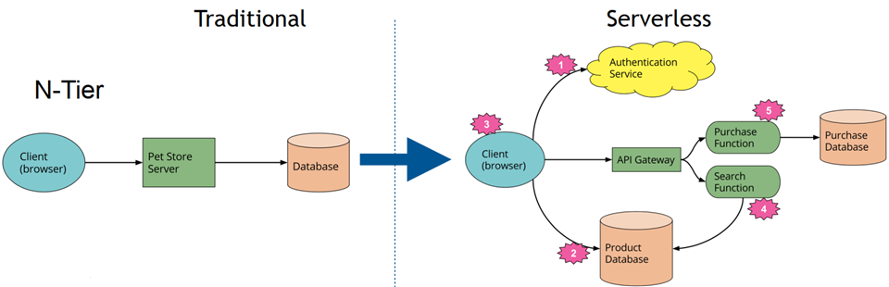
Making switch to Serverless

Slide 4
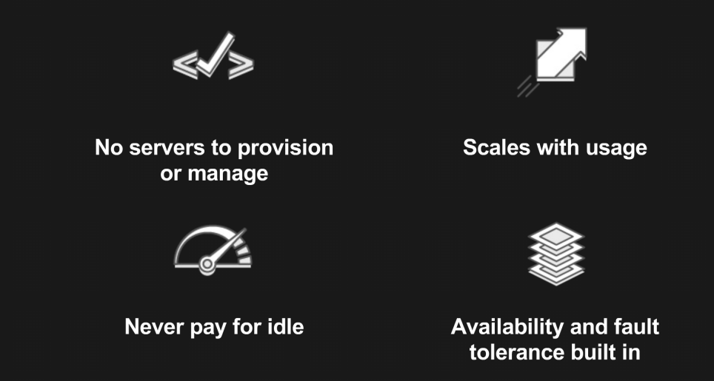
Benefits of Serverless
Notes:
Maintenance: No need to maintain server and all its resources
Scalability: As usage scales, scale up server and scale it down when we don’t have as much usage.
Cost Reduction: Pay only for execution, not for idle, and reduce ops costs
Reliability: Increase reliability of critical apps using modern architectures

Slide 5
What is Serverless?
Serverless is an execution model where the cloud provider is responsible for executing a piece of code by dynamically allocating the resources.
Functions-as-a-Service (FaaS)
The code that is sent to the cloud provider for execution is usually in the form of a function
FaaS offered by the major cloud providers:
AWS: AWS Lambda
Microsoft Azure: Azure Functions
Google Cloud: Cloud Functions

Slide 6
Microservices
While transitioning to a serverless world, our application needs to be architectured in the form of functions
Adopt a more microservice based architecture

Slide 7
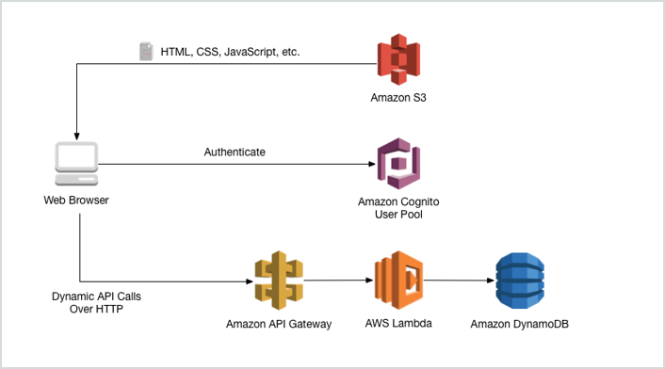
AWS Serverless Architecture
Notes:
Amazon S3 or Amazon Simple Storage Service is a service offered by Amazon Web Services that provides object storage through a web service interface.
Amazon Cognito lets you easily add user sign-up and authentication to your mobile and web apps.
Amazon API Gateway is a fully managed service that makes it easy for developers to create, publish, maintain, monitor, and secure APIs at any scale.
Amazon DynamoDB is a fully managed proprietary NoSQL database service that supports key–value and document data structures.

Slide 8
AWS Lambda
AWS Lambda (or Lambda for short) is a serverless computing service provided by AWS
Lambda specifications:
A container with a 64-bit Amazon Linux AMI
Memory: 128MB - 10240MB, in 1 MB increments
Ephemeral disk space: 512MB - 10240MB, in 1 MB increments
Max execution duration: 900 seconds (15 minutes)
Compressed package size: 50MB
Uncompressed package size: 250MB
Container image package size: 10GB

Slide 9
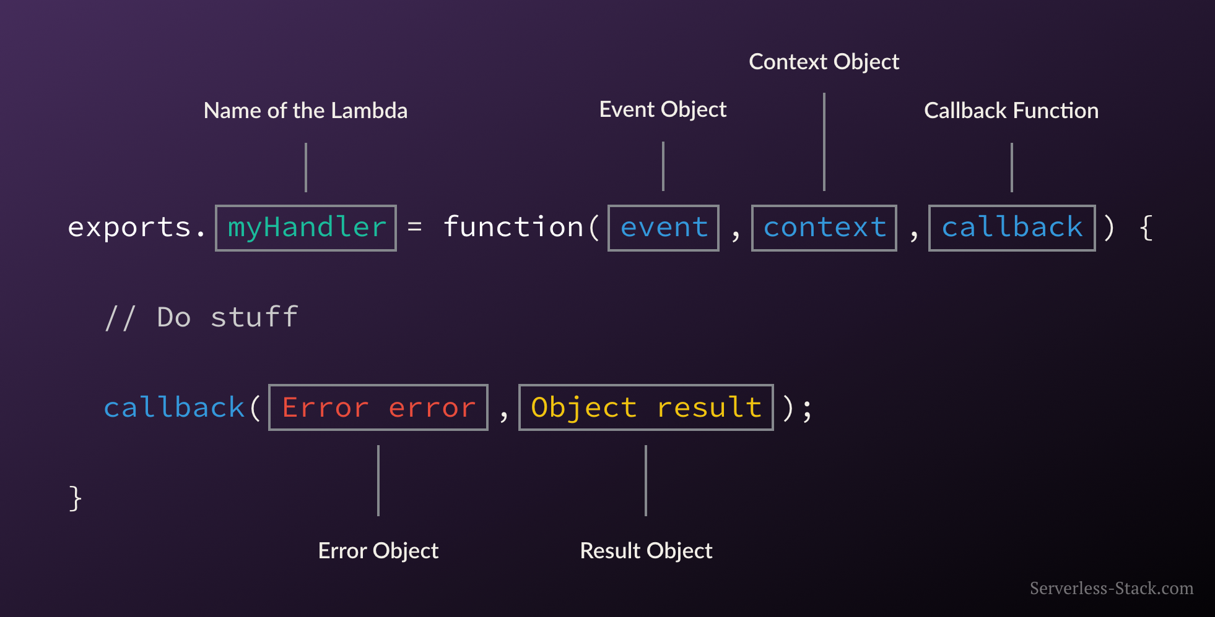
Lambda Function

Slide 10
Packaging Functions
Lambda functions need to be packaged and sent to AWS
A process of compressing the function and all its dependencies and uploading it to an S3 bucket

Slide 11
Execution Model
A new container is brought up to serve a request
The cloud provider simply creates multiple instances of the container with our function to serve those requests
Cannot handle concurrent requests

Slide 12
Stateless Functions
Functions are typically run inside secure (almost) stateless containers
A function is invoked in a new container every single time
Functions running inside a container that is brought up on demand to respond to an event. This is referred to as a Cold Start.
Container may keep up after function has complete execution. If another event is triggered during this time it responds far more quickly and this is typically known as a Warm Start.

Slide 13
Serverless Stack Framework (SST)
A framework that makes it easy to build serverless apps
SST makes it easy to build serverless applications by allowing developers to:
Define their infrastructure using AWS CDK (Cloud Development Kit)
Test their applications live using Live Lambda Development
Set breakpoints and debug in Visual Studio Code
Web-based dashboard to manage your apps
Deploy to multiple environments and regions
Use higher-level constructs designed specifically for serverless apps
Configure Lambda functions with JS and TS, Python, C#, etc.

Slide 14
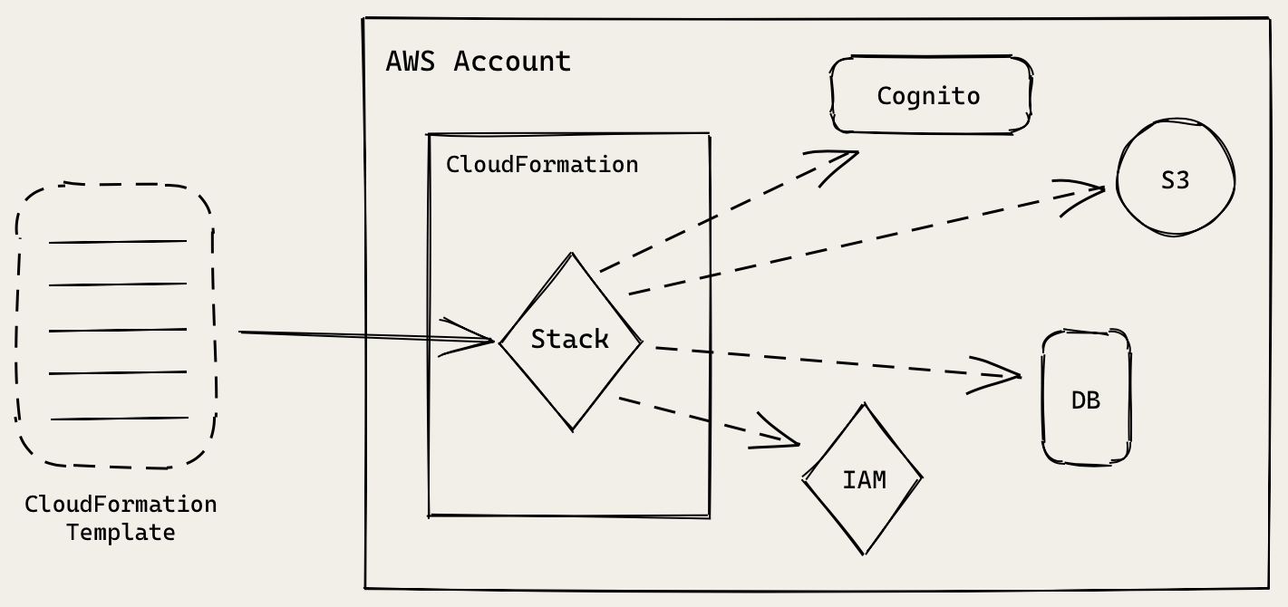
AWS CloudFormation
SST converts infrastructure code into a CloudFormation template
CloudFormation is an AWS service that takes a template (written in JSON or YAML), and provisions resources based on that.

Slide 15
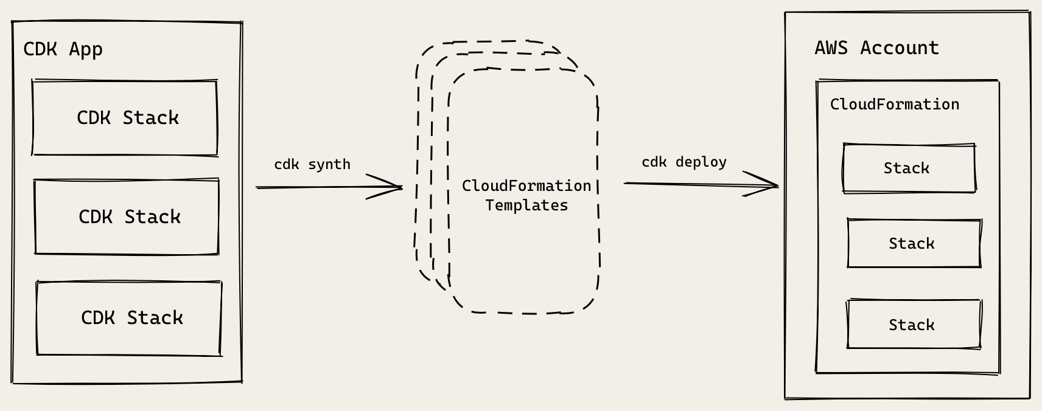
AWS CDK (Cloud Development Kit)
Converts code into a CloudFormation template
Uses CloudFormation internally

Slide 16
Authentication in Serverless Apps
Cognito User Pool
An AWS service to manage sign up and login functionality for users
It will store user’s login info
It will also be managing user sessions in React app
Cognito Identity Pool
An AWS service to manage access control to our AWS infrastructure
This service decides if previously authenticated user has access to the resources he/she is trying to connect

Slide 17
Authentication Role
Cognito Identity Pool has a set of rules (called an IAM Role) attached to it
It will list out the resources an authenticated user is allowed to access. These resources are listed using an ID called ARN (Amazon Resource Names).
Notes:
IAM: Identity and Access Management

Slide 18
Authenticated API Requests
To connect to API:
The React client makes a request to API Gateway secured using IAM Auth.
API Gateway will check with Identity Pool if the user has authenticated with User Pool.
It will use the Auth Role to figure out if this user can access this API.
If everything looks good, then our Lambda function is invoked and it will pass in an Identity Pool user id.

Slide 19
Alternative Authentication Methods
Use Facebook or Google as an authentication provider
Manage users and authentication yourself
You might not be able to manage access control centrally to the S3 bucket (or any other AWS resources in the future).

Slide 20
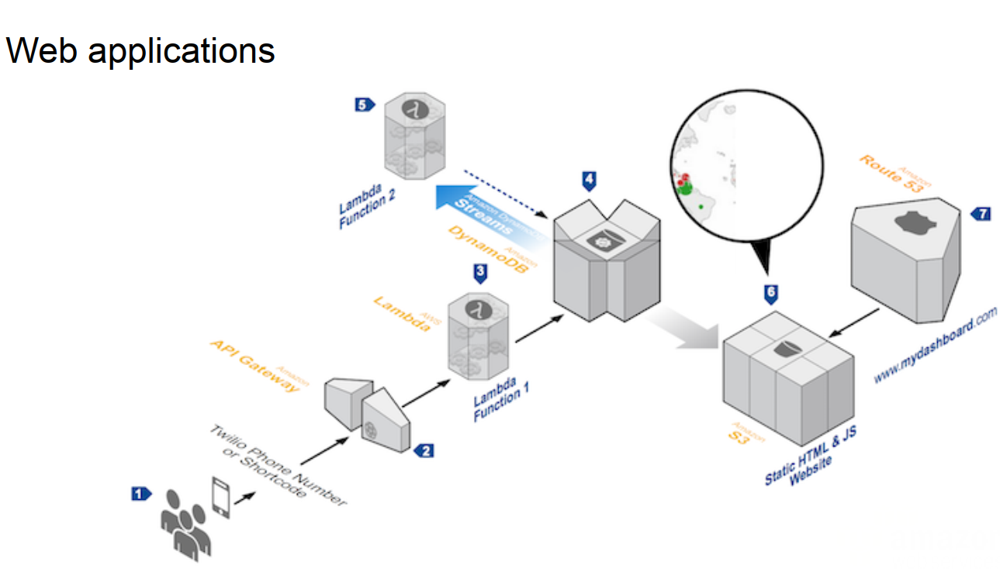
Serverless in Practice - Architecture

Slide 21
Installation
To use SST you will need:
Node.js >= 10.15.1
An AWS account with the AWS CLI configured locally
Install the AWS Toolkit for Visual Studio Code
As an extension
Install AWS SAM CLI
https://aws.amazon.com/serverless/sam/

Slide 22
SST CLI
Installation command
npm install @serverless-stack/cli -g
npm install create-sst -g
Create your first SST app
npm init sst # Create a new SST app
npm start

Slide 23
Project layout
An SST app is made up of three parts:
stacks/ — App Infrastructure
The code that describes the infrastructure of serverless app is placed in the stacks/directory of the project. SST uses AWS CDK, to create the infrastructure.
backend/ — App Code
The Lambda function code that’s run when the API is invoked is placed in the backend/ directory of the project.
frontend/ — directory for frontend React app

Slide 24
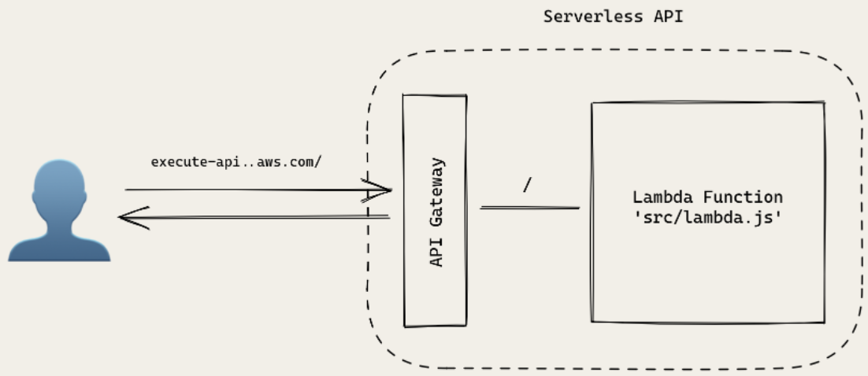
Hello World API Architecture

Slide 25
Serverless is Good and Not Good for
Short-running
Stateless
Event-driven
Microservices
Mobile Backends
Bots
IoT
Service Integration
Stream processing
Long-running
Stateful
Number crunching
Databases
DL training
Heavy-duty stream analytics
Numeric simulation
Video streaming

Slide 26
Some Resources
https://serverless-stack.com/
https://webapp.serverlessworkshops.io/
https://github.com/aws-samples/lambda-refarch-webapp

Slide 27
Thank you!

